Slide 1
LINQ Language Integrated Query Chapter 17 LINQ to SQL
Book: ADO.NET 4 C#
© 2011, Mike Murach & Associates, Inc.

Slide 4
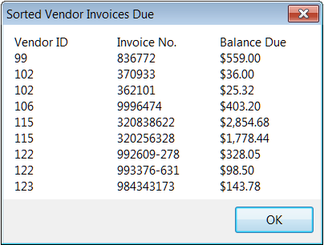
Notes:
4

Slide 10
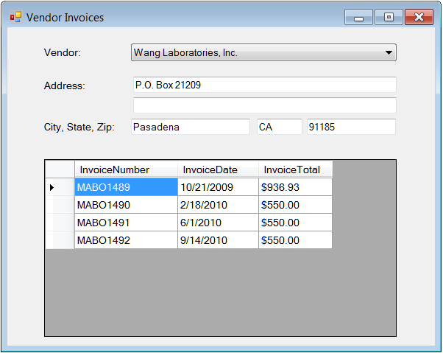
Notes:
10

Slide 11
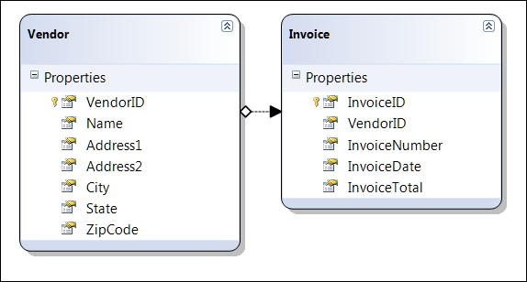
Notes:
11

